Slide 1
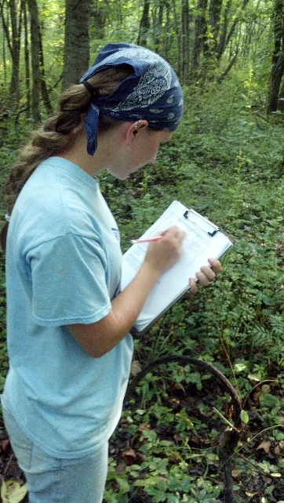
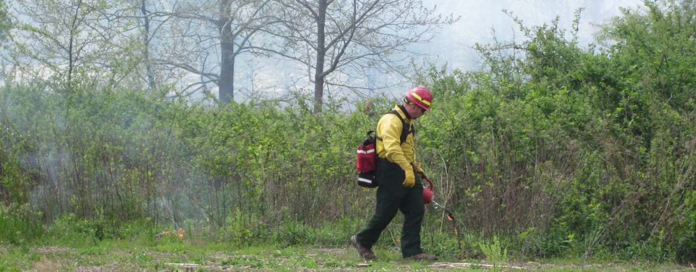
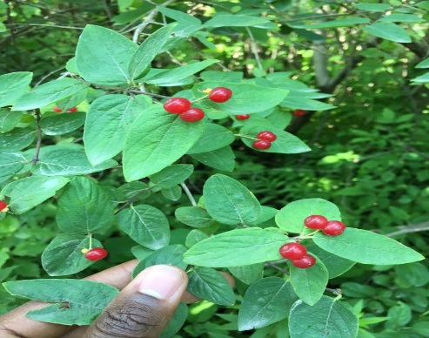
How Invaded Are Our Forests?
FOREST INVASIVES ADAPTIVE MANAGEMENT
FIAM Forest Management Burn Treatment, USFWS
FIAM Inventory volunteer, USFWS
THE FOREST INVASIVES ADAPTIVE MANAGEMENT PROJECT
Invasive plants are a top threat to our national wildlife refuges, but we do not have the resources to manage all invasive plants on refuge lands. In FY 2015, it was reported that 519,308 acres of Region 3 refuge lands were infested by invasive plants; we were only able to treat 4.2% of those lands. It is imperative to strategically apply our resources towards the most effective management actions.
Treating invasive plants within a large area is a complex problem with many considerations: where and when to treat, which method to use, and what species to target. Currently, management actions to address invasive plants are often implemented in unstructured ways at small, local scales that don’t take into account the full distribution of invasive plants on the refuge. This usually results in recurring infestations, new invasions by untargeted species, uncertainty in the effectiveness of the treatment, and/or an incomplete understanding of the problem. Furthermore, it is U.S. Fish and Wildlife Service policy to monitor before, during, and after any invasive plant treatment to assess effectiveness and observe any possible unanticipated impacts (569 FW 1.4J).
The Region 3 Eastern Broadleaf Forest Biological Network began developing Forest Invasives Adaptive Management (FIAM) project on national wildlife refuges in southern Indiana, Illinois, and Missouri in 2009. FIAM was developed to provide refuge biologists and managers with a framework for tackling invasive plants in a way that is cost effective and compatible with policy.
Vision
A landscape where forested blocks resist invasion by non-native plants, and serve as oases of biodiversity for native species.
Snowy Egret. William Majoros
Mission
To aid in the restoration of forest habitats for native biota, by providing managers with the resources to assess and treat invasive plant species.
Goal
To provide refuge biologists and managers with a framework for tackling invasive plants in a way that is cost effective and compatible with policy.
WHAT ARE WE LEARNING?
The FIAM project addresses invasive plant management at two scales: the entire refuge scale and a smaller, management grid scale. FIAM formalizes a step-by-step process for 1) mapping invasive species distributions, 2) prioritizing the location of management actions, 3) treating the invasives, and 4) evaluating the effectiveness of the treatments. We developed a model to make predictions about treatment outcomes. Pre- and post-treatment data from each participating refuge are used to update the model predictions over time. In this way, the FIAM project can “learn” over many iterations of the process and adaptively manage invasive plants far more effectively than a static management program at a single refuge.
The first iteration of the treatment/monitoring cycle has highlighted the mismatch between the scope of the problem and the resources available to deal with it. Many stations struggle to find the resources to conduct the inventories and monitor their treatments. They want to be able to treat small areas when they find them, especially new, and potentially aggressive, non-native plants. We want to improve the project to make it feasible and useful for stations to participate. We’re engaging the managers and station biologists to hear what their most pressing concerns are and what constraints they face in assessing and treating invasive species. And, we’re reaching out to other regions with a long history of invasive species experience to see how they are addressing these constraints.
Tartarian honeysuckle, Joshua Booker USFWS

Slide 2
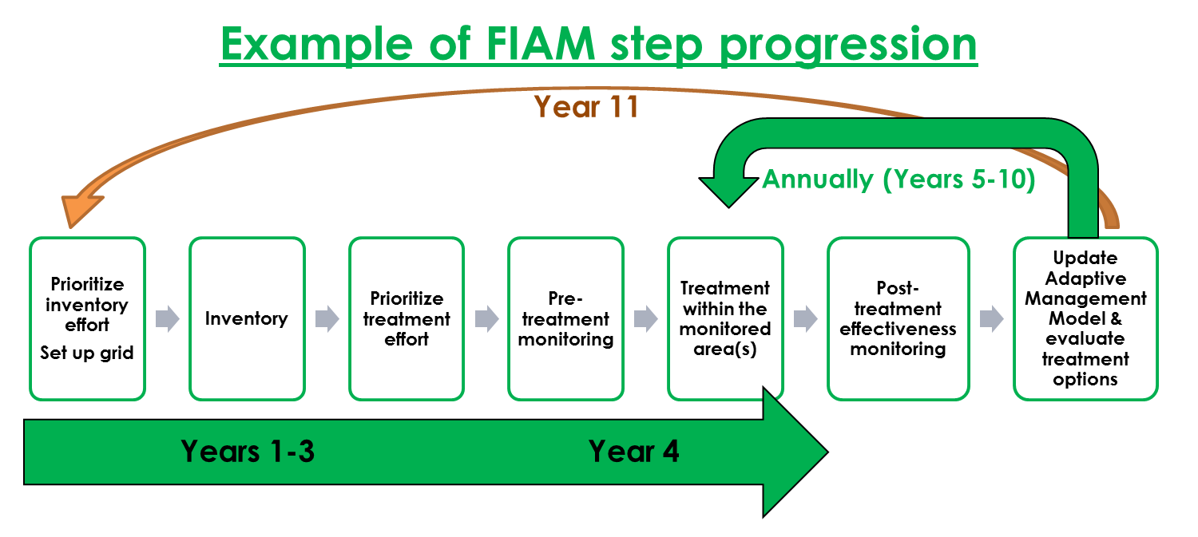
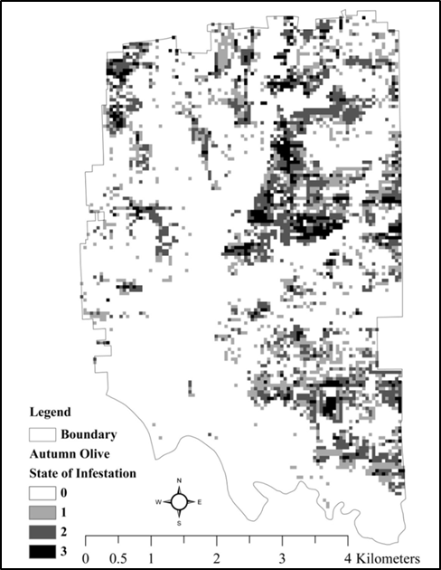

WHAT’S NEXT?
The FIAM Regional Protocol Framework version was finalized in April, 2017. The FIAM project will improve over time as more refuges begin to use it and its models. We look forward to fully integrating our various models and tools to provide a seamless decision support system for the refuge users. Although FIAM is currently focused on forest ecosystems, the project is flexible enough to be applied to other types of habitats if there is enough interest. The project continues to evolve. We recognize the major challenges of managing invasive species, and we want to maintain a focus on meeting managers’ needs. Contact your Zone Biologist if your station is interested in participating.
JOIN THE FIAM PROJECT
Seven Region 3 stations are participating in FIAM. In total, these refuges plan to inventory 80,860 acres. All products from the project are available for other refuges to use; refuge managers can find protocols for the invasive plant inventory and effectiveness monitoring on our ServCat project page. We also manage a SharePoint site for cooperators that has protocols, resources, and a centralized database. A Collector for ArcGIS mobile app is available to streamline data collection into our ArcGIS Online database. A FIAM-specific user guide is available here.
Map of Muscatatuck NWR depicting the 0.25-hectare grid cells that were invaded by autumn olive. Darker shaded cells indicate a higher infestation level. These data are based on the 2011 FIAM inventory conducted at Muscatatuck.
THE NUMBERS
Dates: 2009 - Present
Number of Refuges: 7 enrolled
Acres to be inventoried: 80,860
Acres inventoried thus far (as of 8/21/2018): 54,350
Monitored acres: 53.6
CONTACT INFORMATION
Joshua Booker, Zone Biologist: joshua_booker@fws.gov
Amanda McColpin, Project Coordinator: amanda_mccolpin@fws.gov
Visit our ServCat Project: https://ecos.fws.gov/ServCat/Reference/Profile/37545
More about the FIAM project: https://www.fws.gov/Midwest/Planning/r3ssd/main.html?booker_invasive_plant_management
Updated August, 2018

