Slide 1
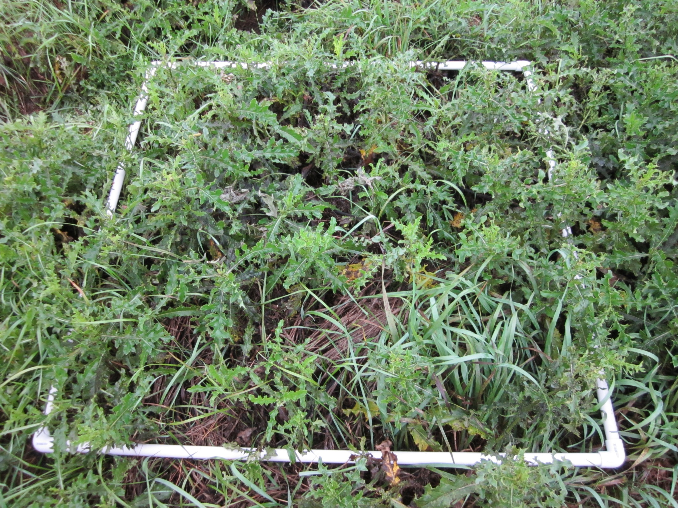
September 4, 2014 WWS Thistle Bug Release Points #1

Slide 2
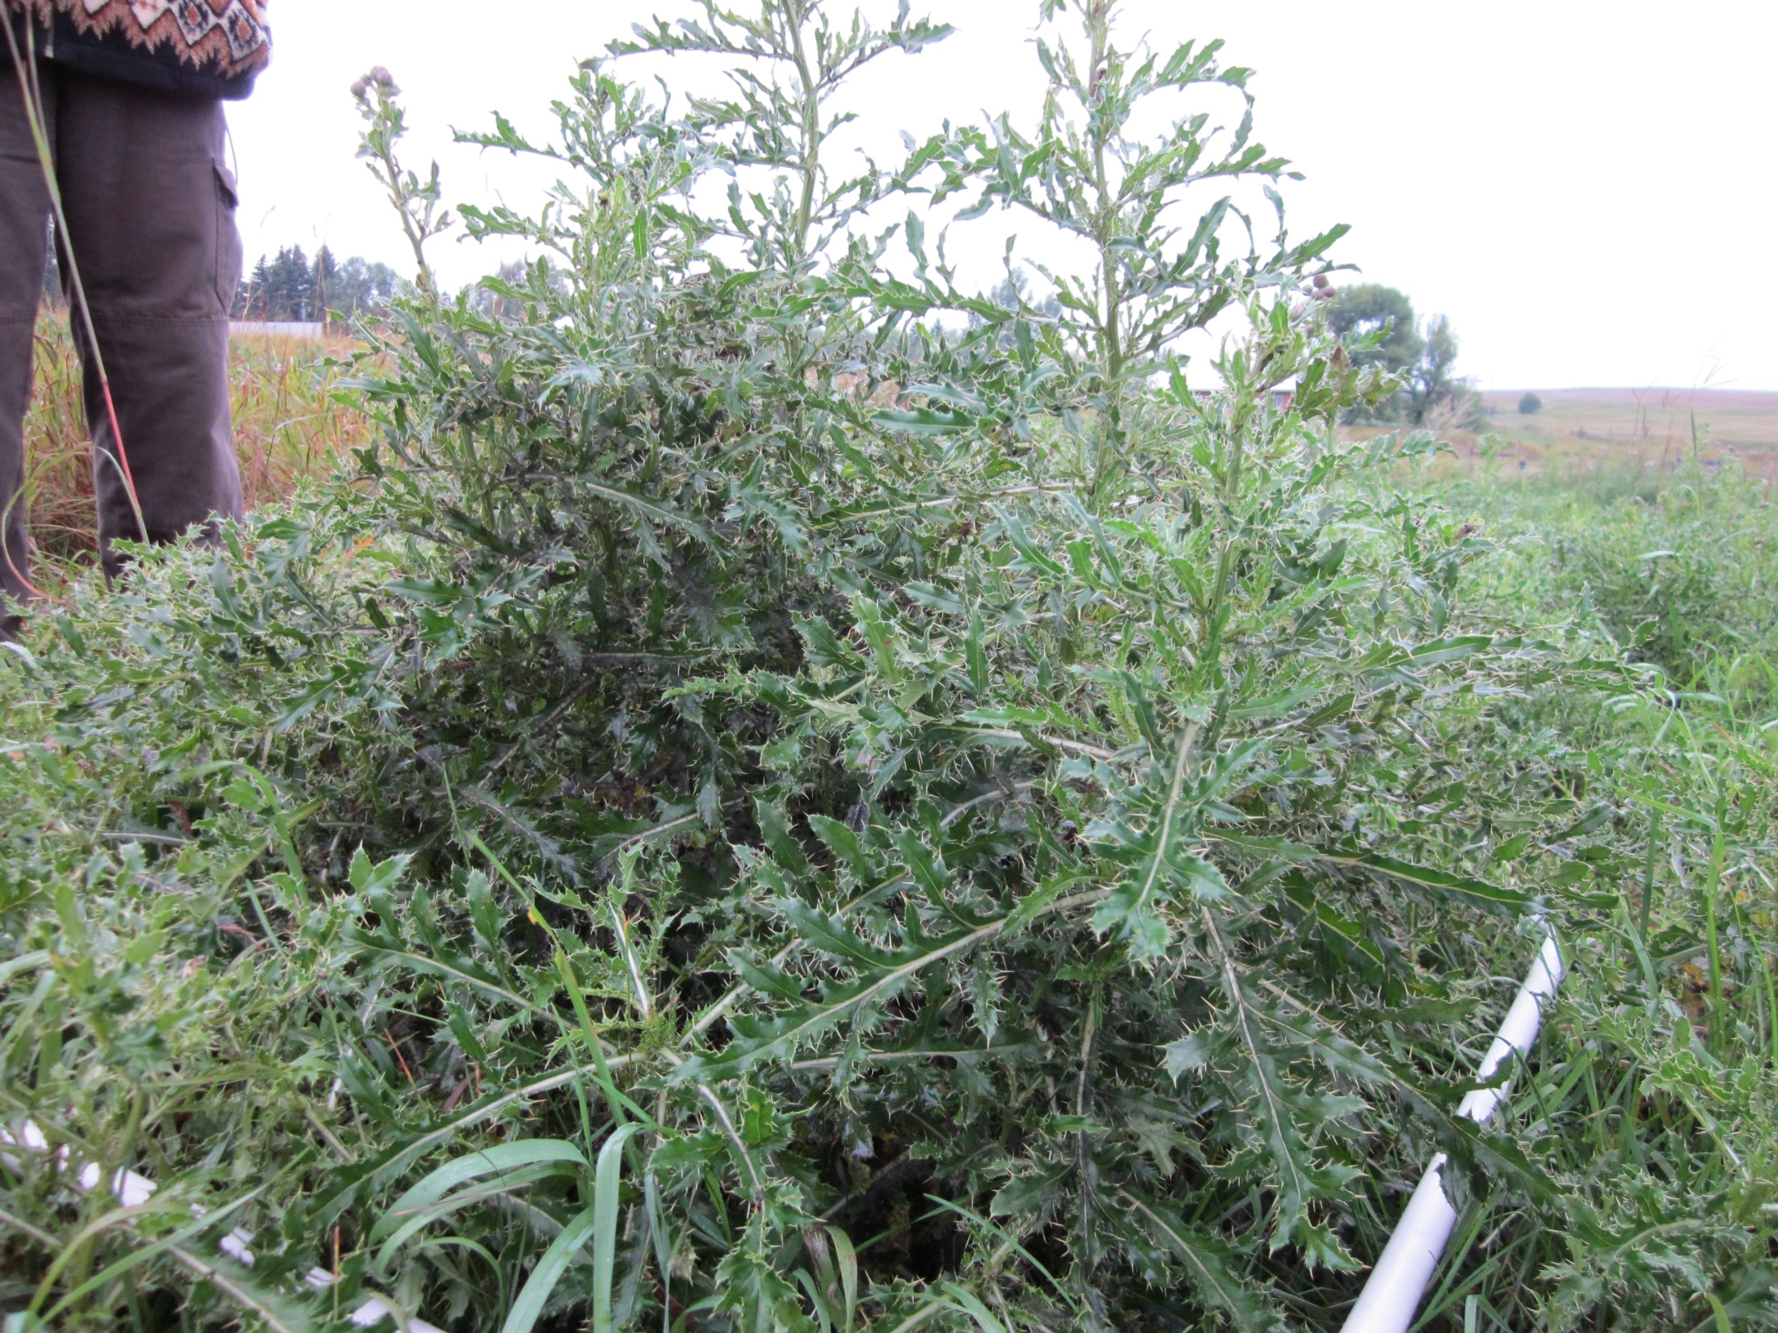
September 4, 2014 WWS Thistle Bug Release Points #2

Slide 3
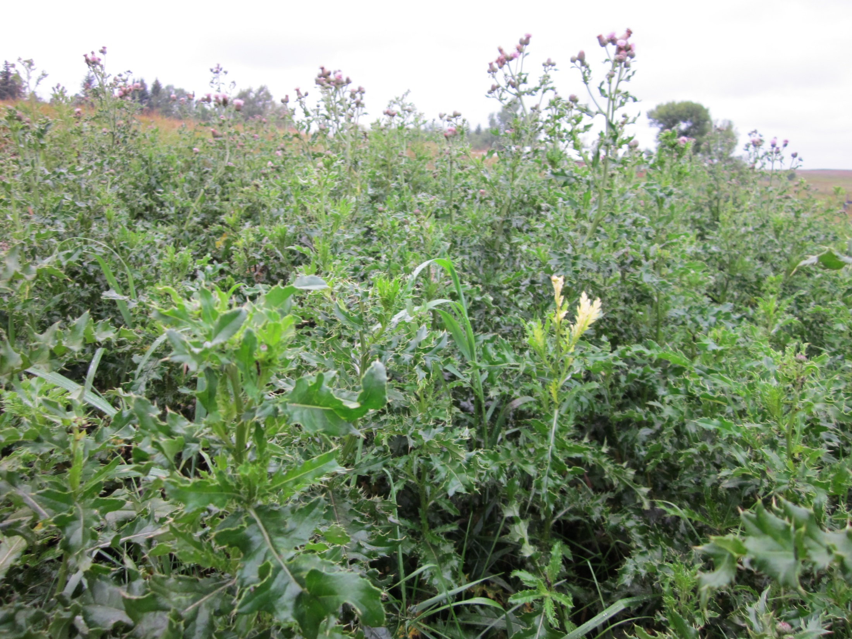
September 4, 2014 WWS Thistle Bug Release Points #3

Slide 4
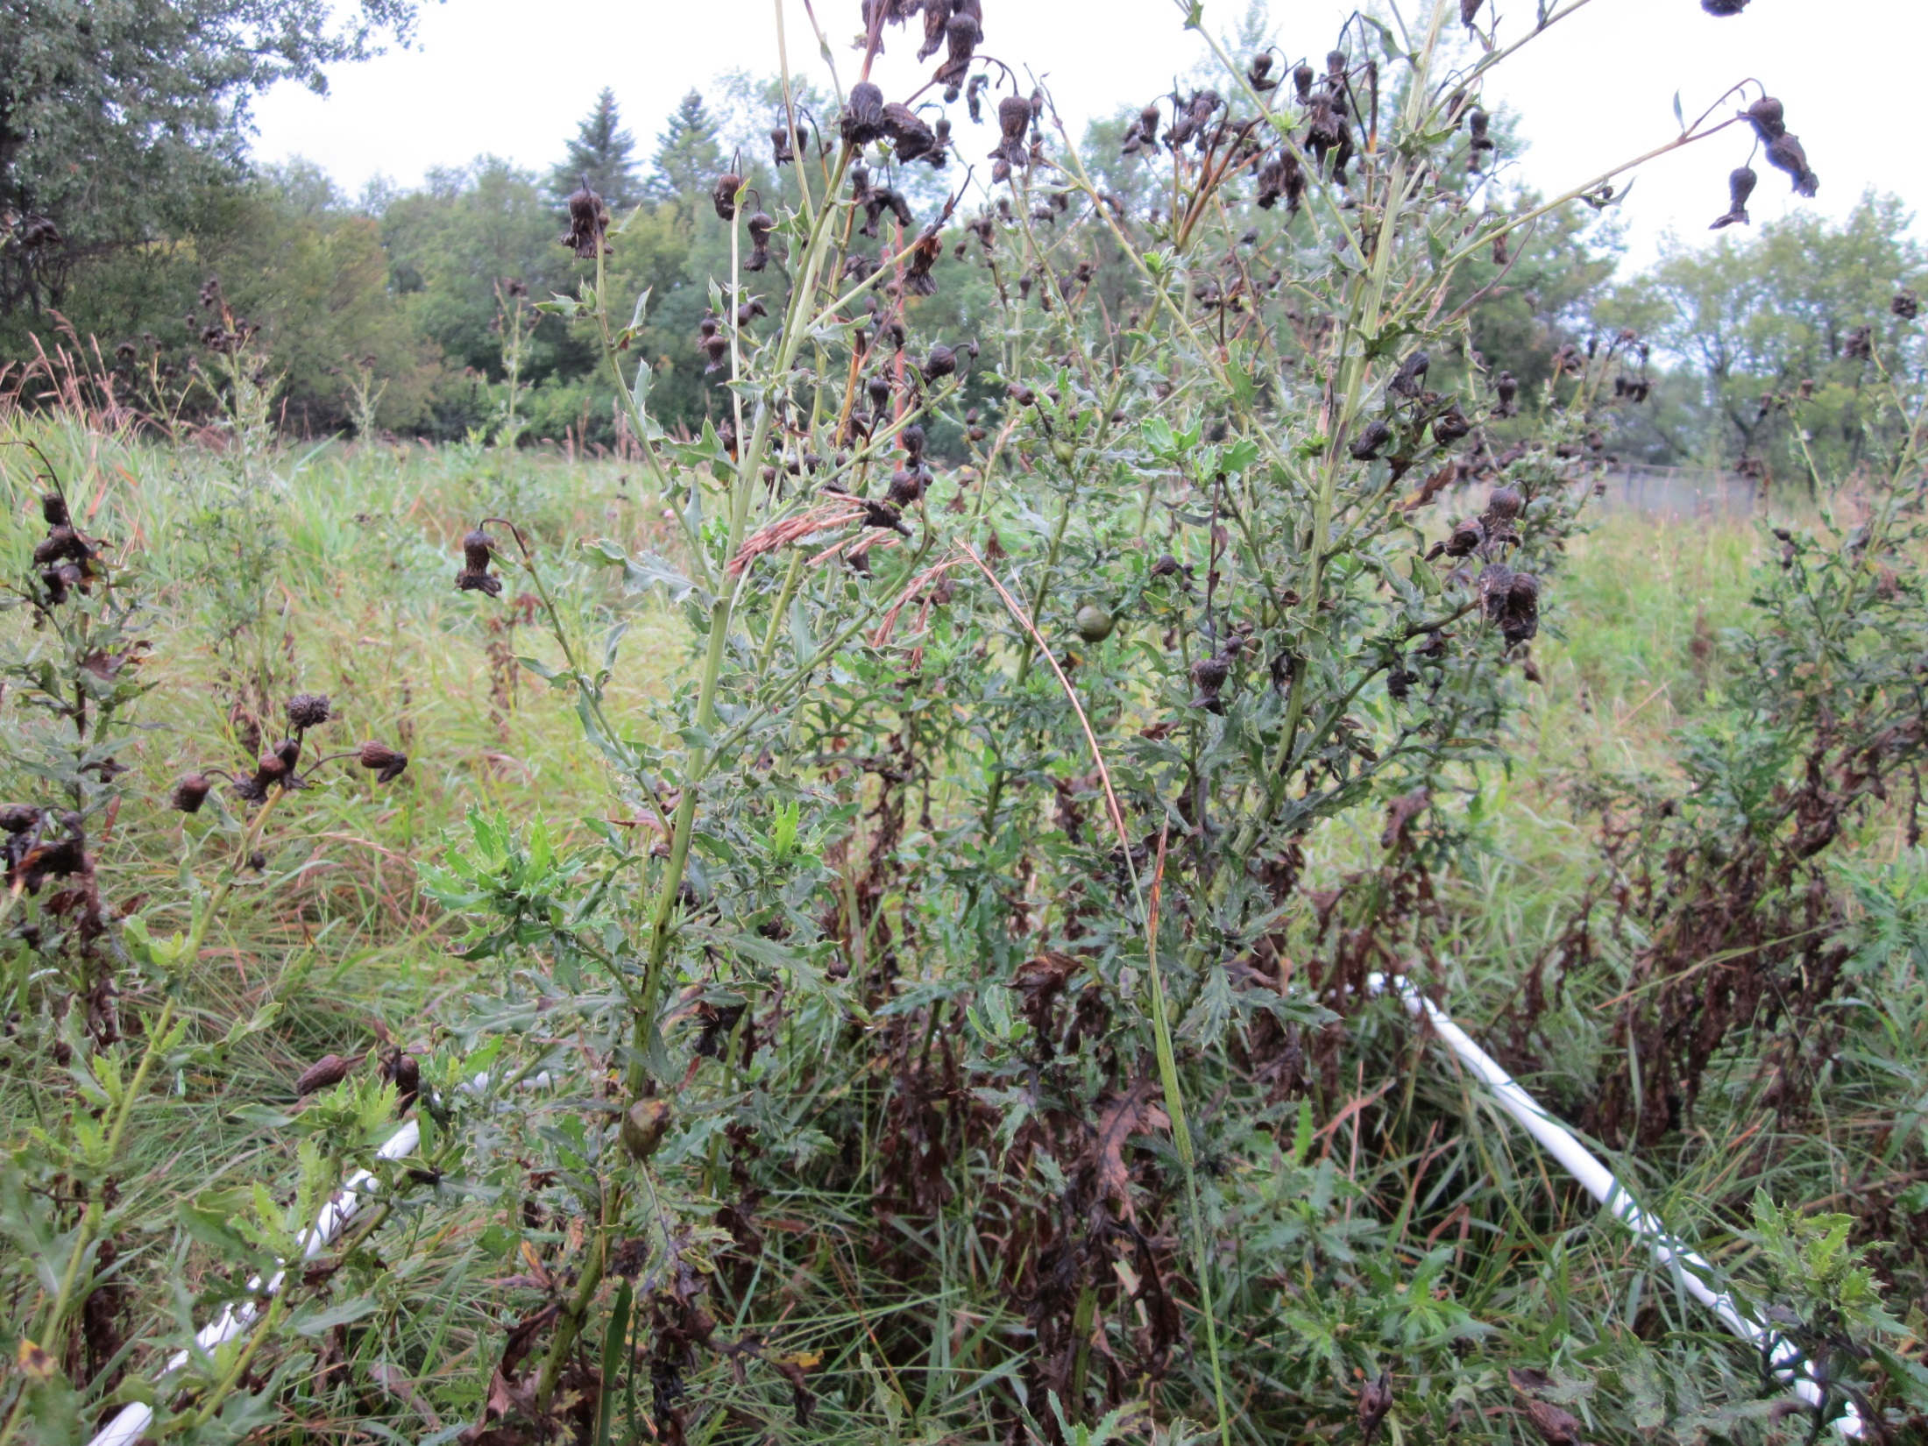
September 4, 2014 WWS Thistle Bug Release Points #4

Slide 5
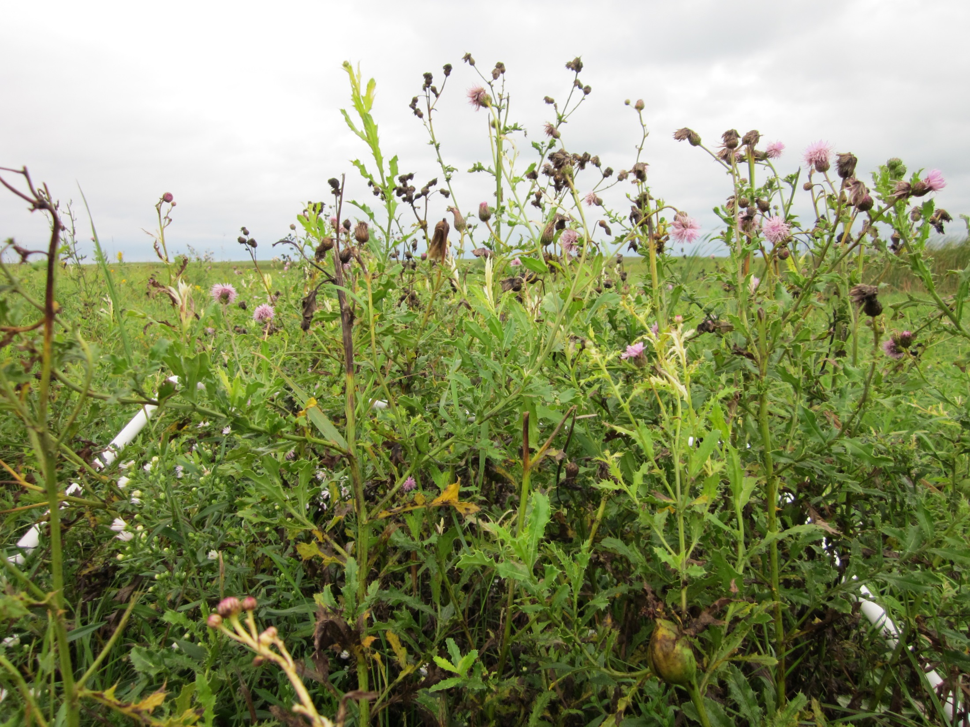
September 4, 2014 WWS Thistle Bug Release Points #5

Slide 6
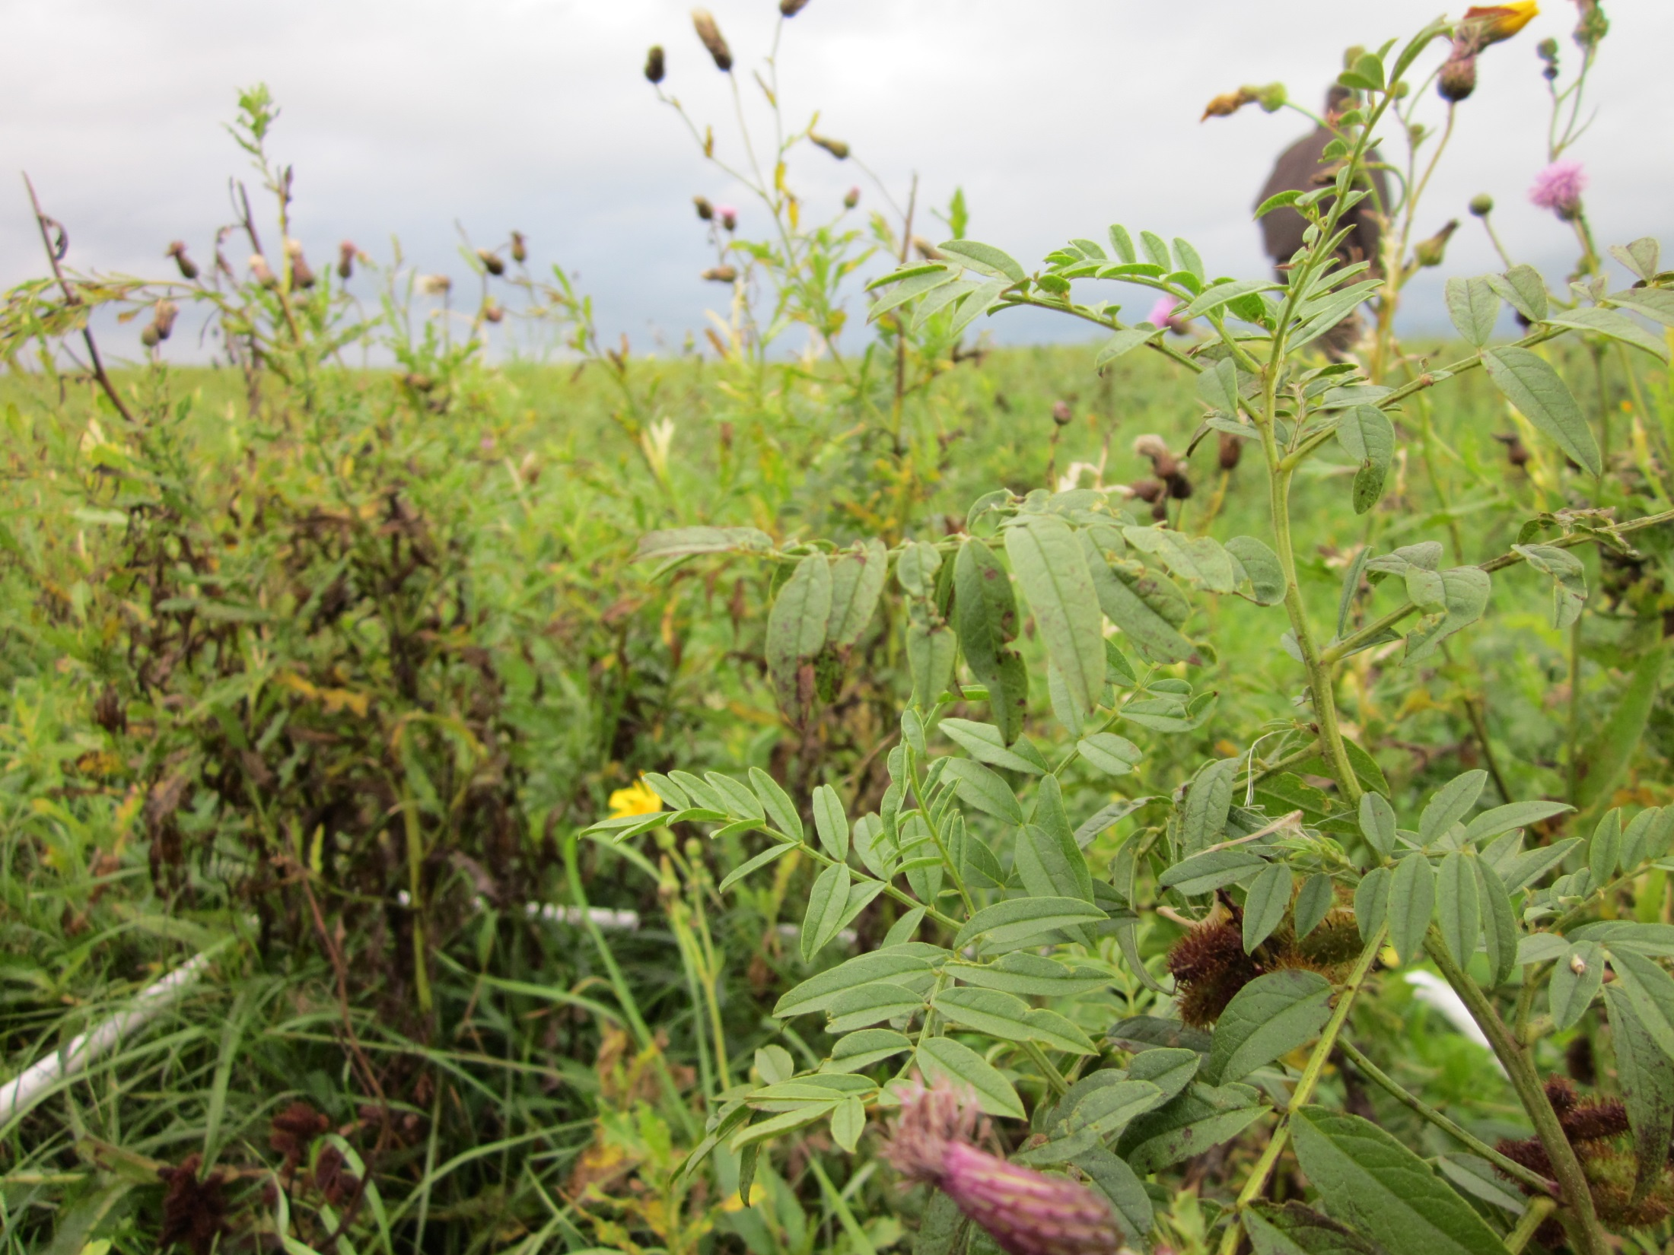
September 4, 2014 WWS Thistle Bug Release Points #6

Slide 7
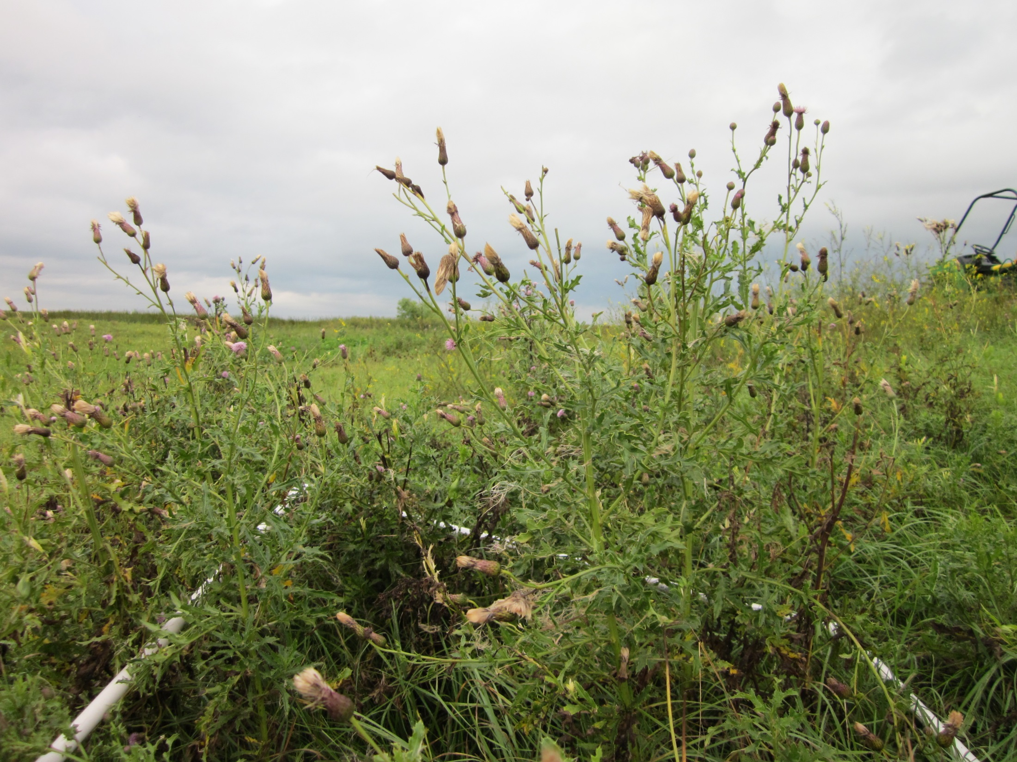
September 4, 2014 WWS Thistle Bug Release Points #7

Slide 8
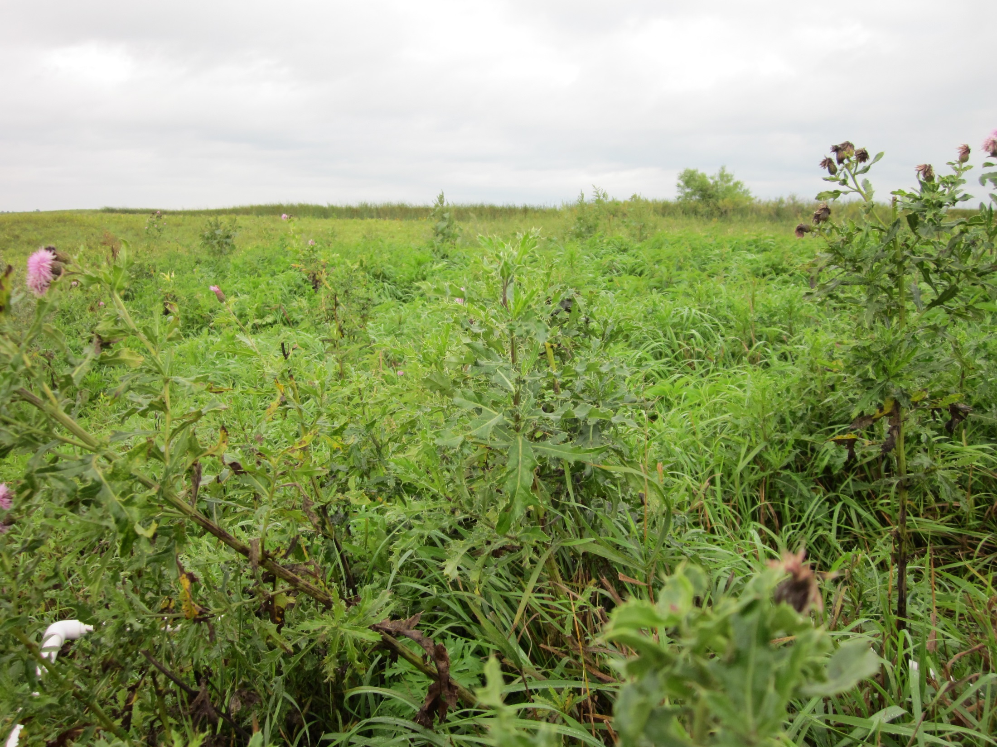
September 4, 2014 WWS Thistle Bug Release Points #8

Slide 9
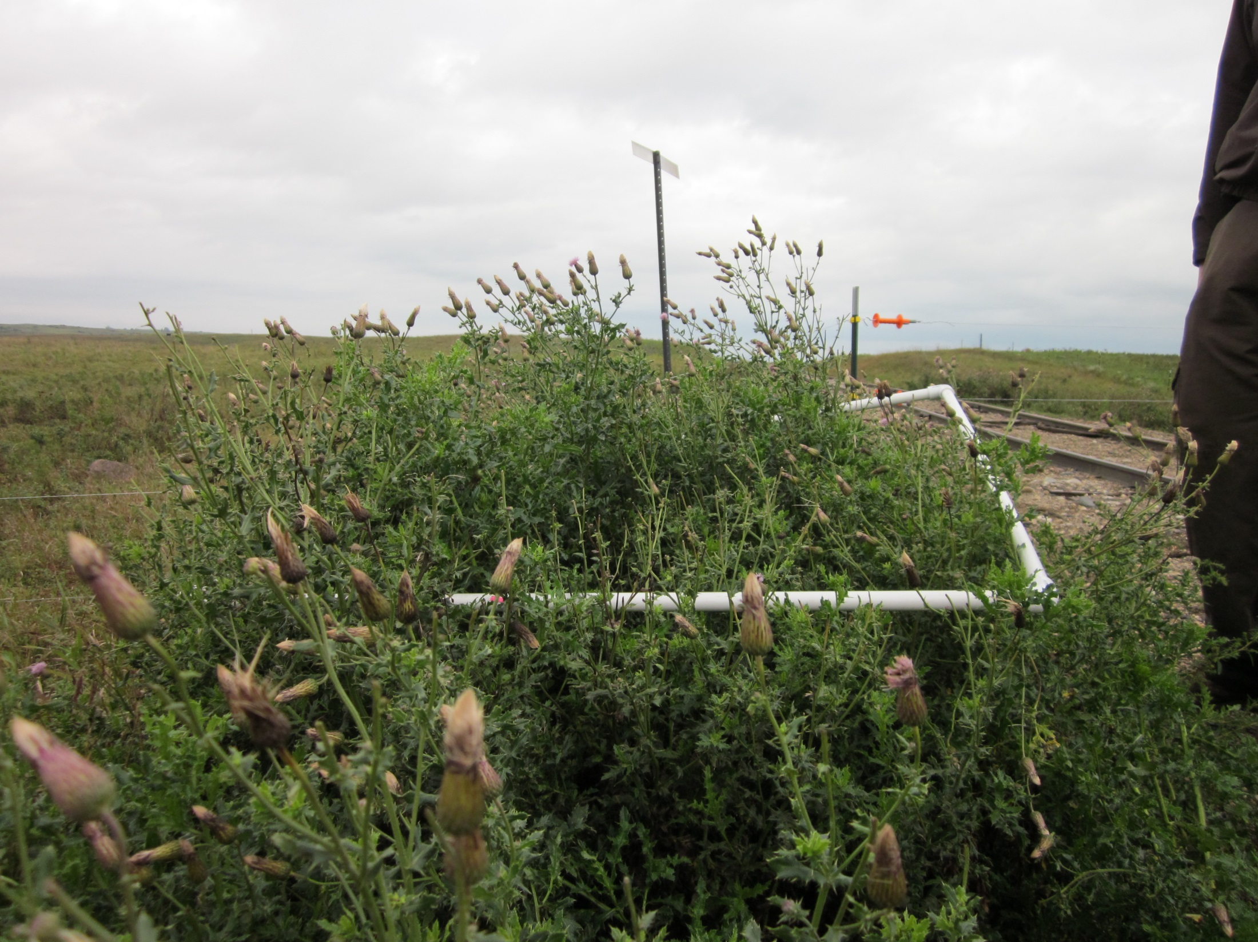
September 4, 2014 WWS Thistle Bug Release Points #9

Slide 10
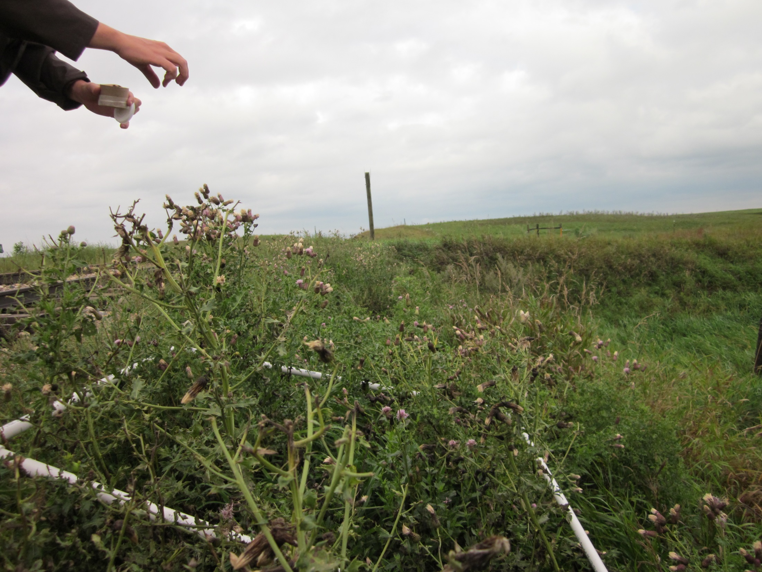
September 4, 2014 WWS Thistle Bug Release Points #10

Slide 11
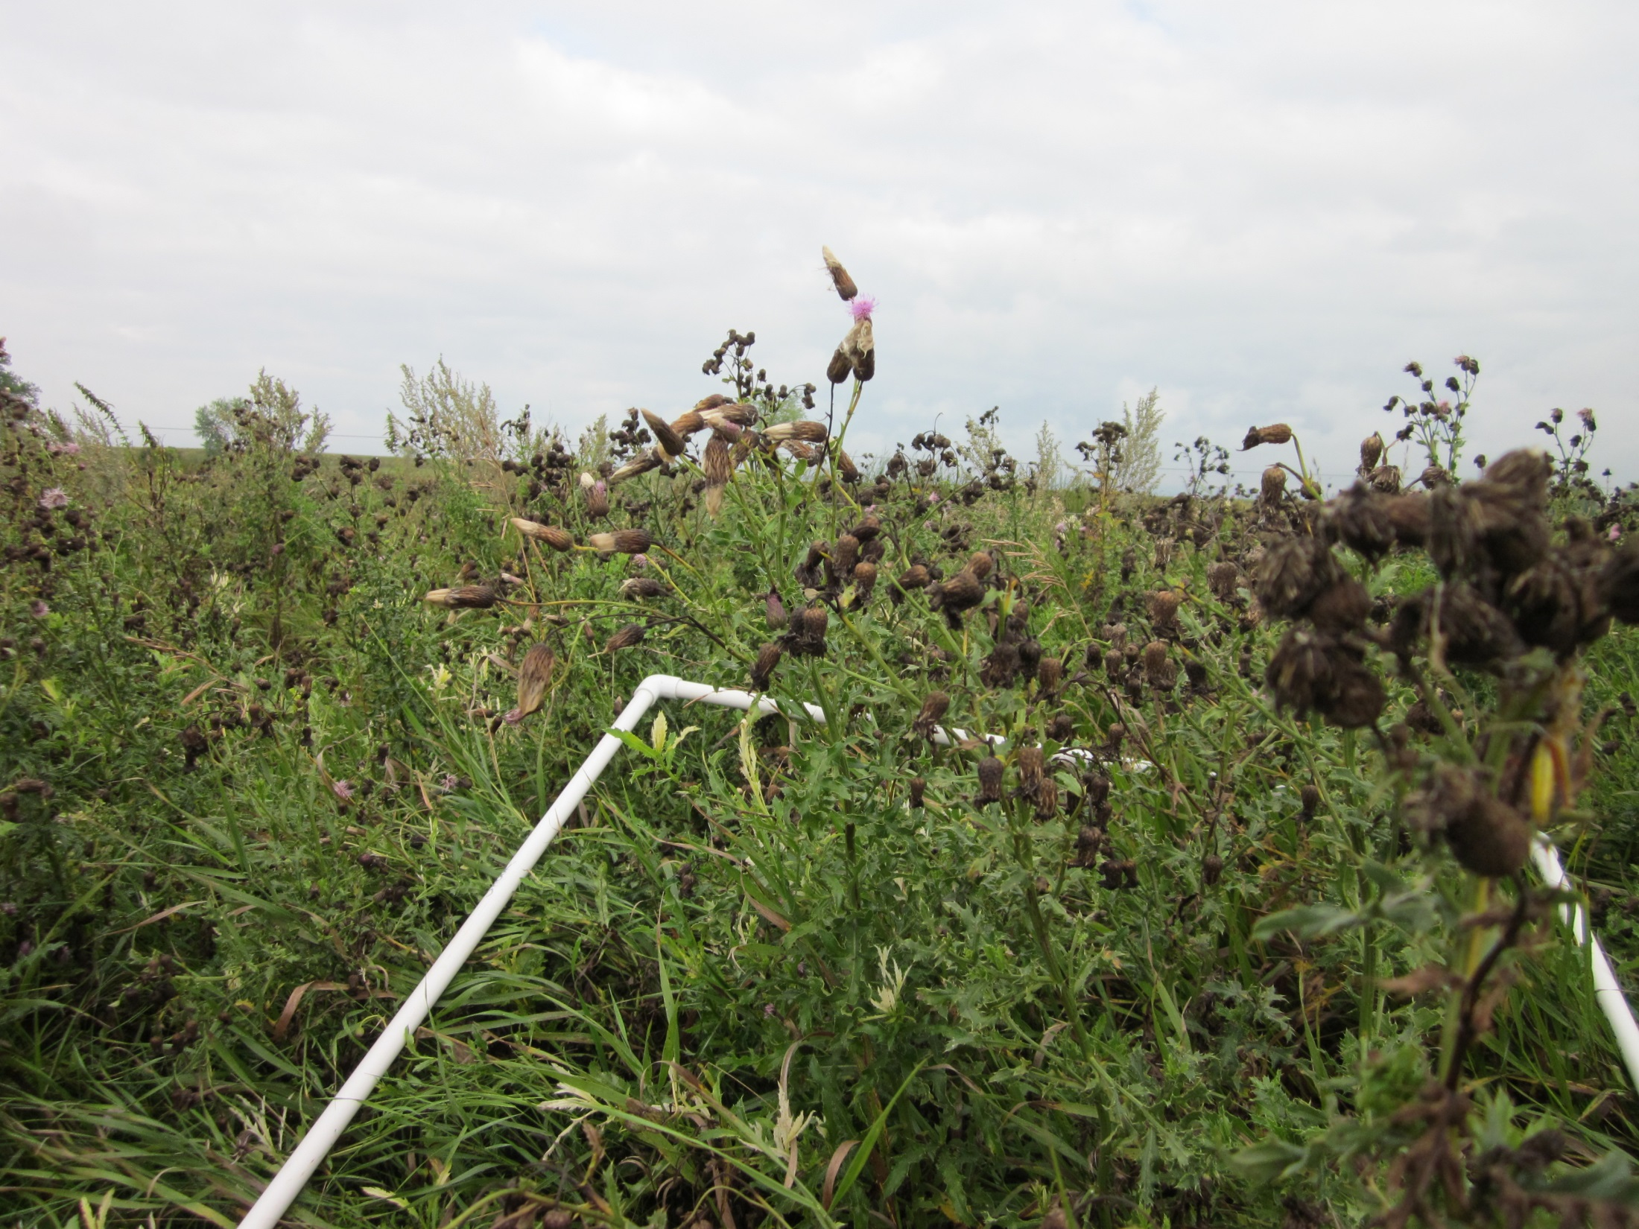
September 4, 2014 WWS Thistle Bug Release Points #11

Slide 12
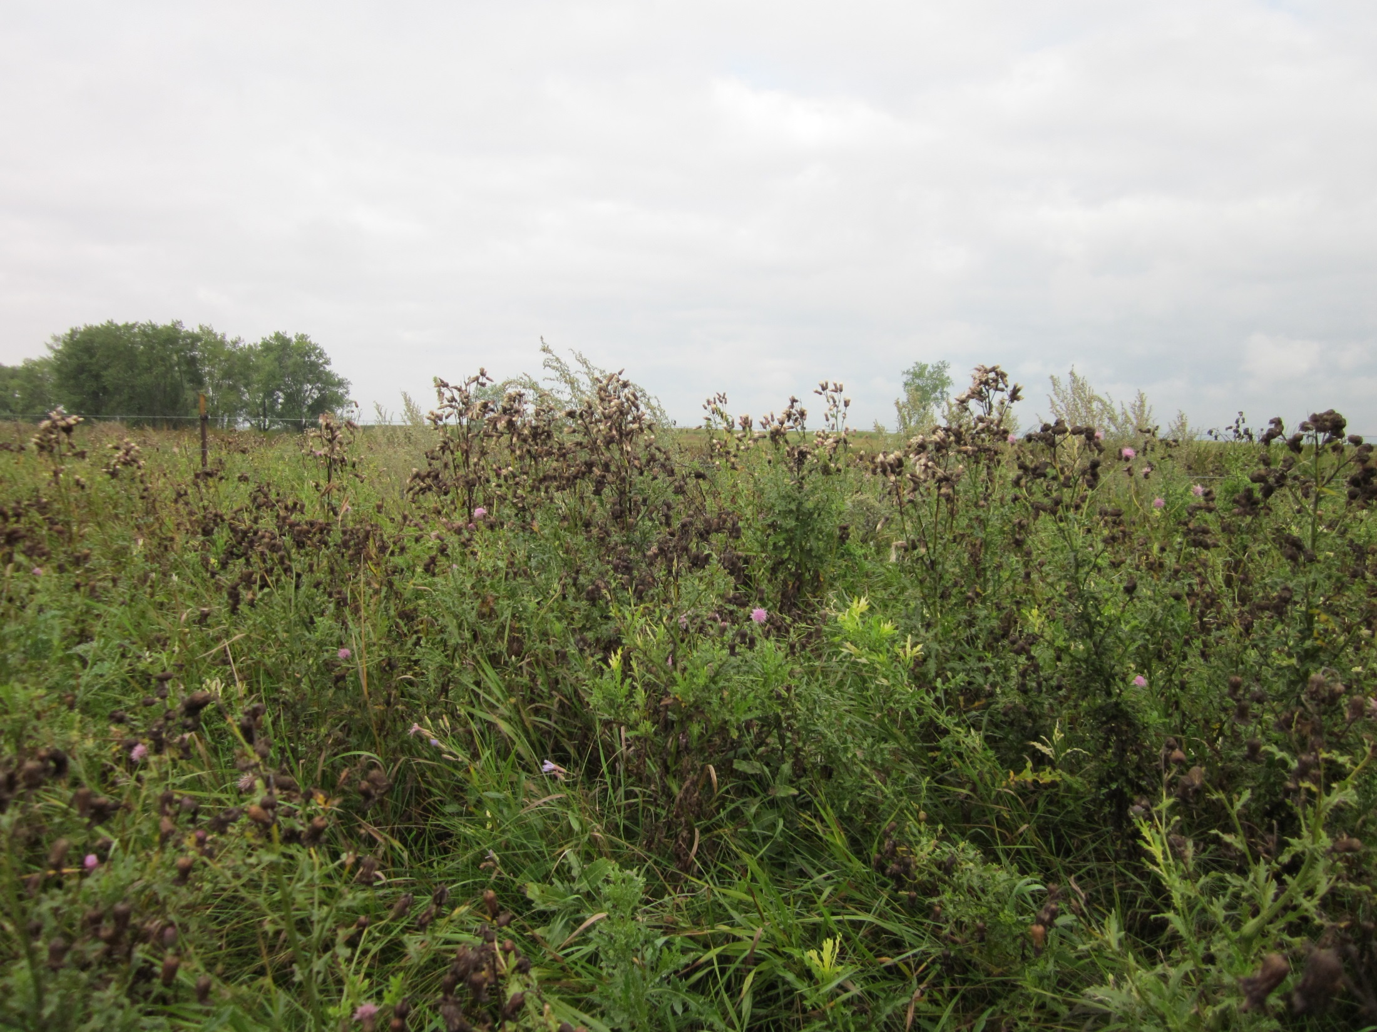
September 4, 2014 WWS Thistle Bug Release Points #12

Slide 13
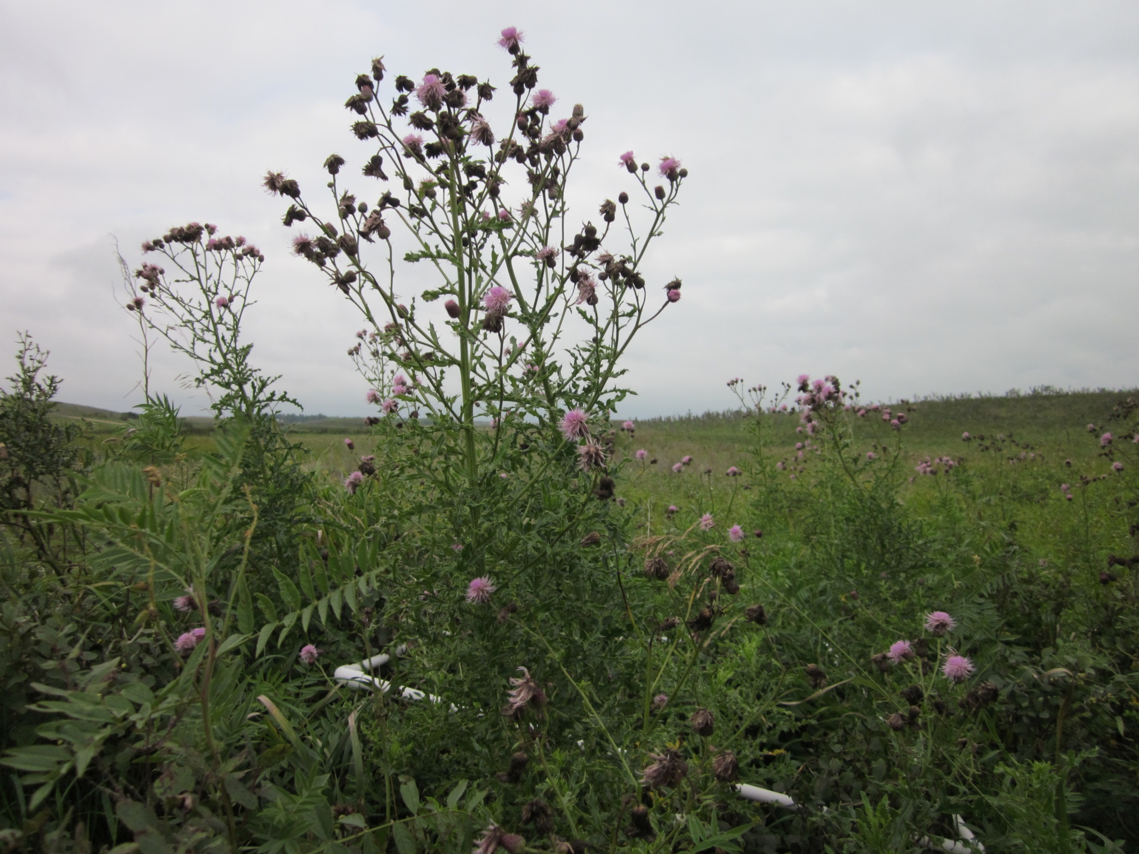
September 4, 2014 WWS Thistle Bug Release Points #13

Slide 14
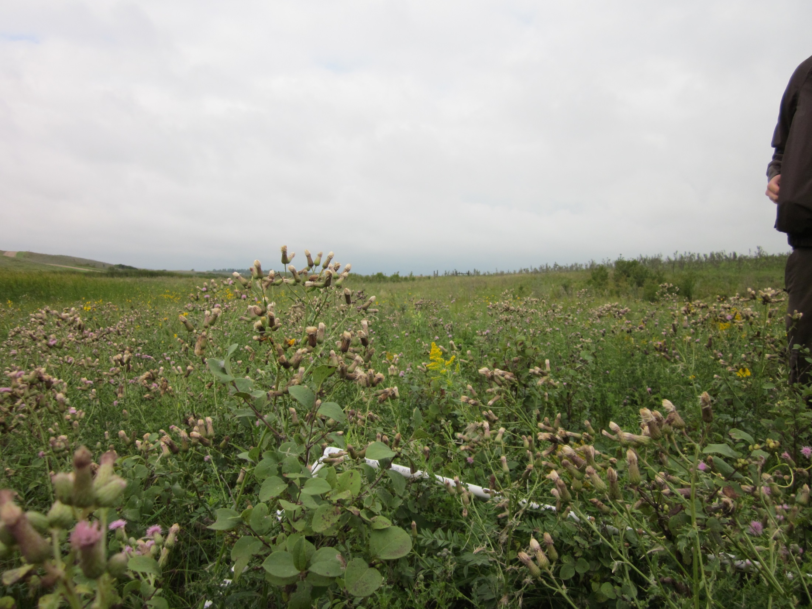
September 4, 2014 WWS Thistle Bug Release Points #14

Slide 15
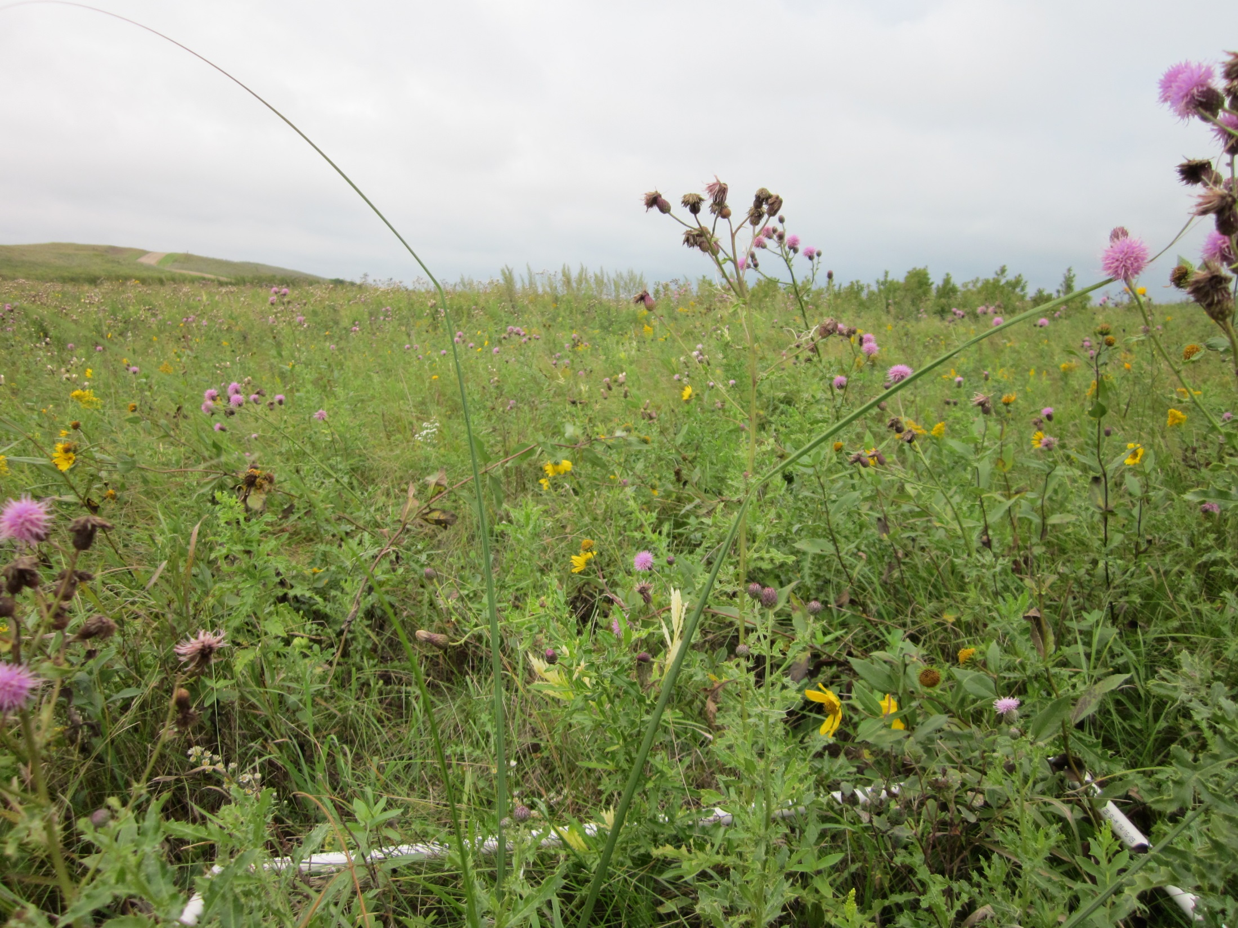
September 4, 2014 WWS Thistle Bug Release Points #15

